Slide 1
Tutorial for Case 4
Multi-solvent design for perovskite thin film materials

Slide 2
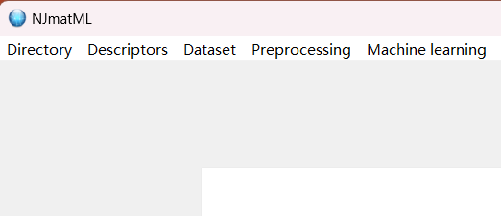
Choose your save path
Click this button and choose your save path

Slide 3
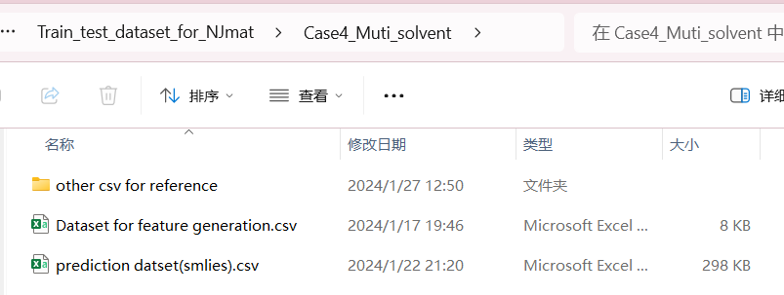
Data import for feature generation
Choose this dataset as an example

Slide 4
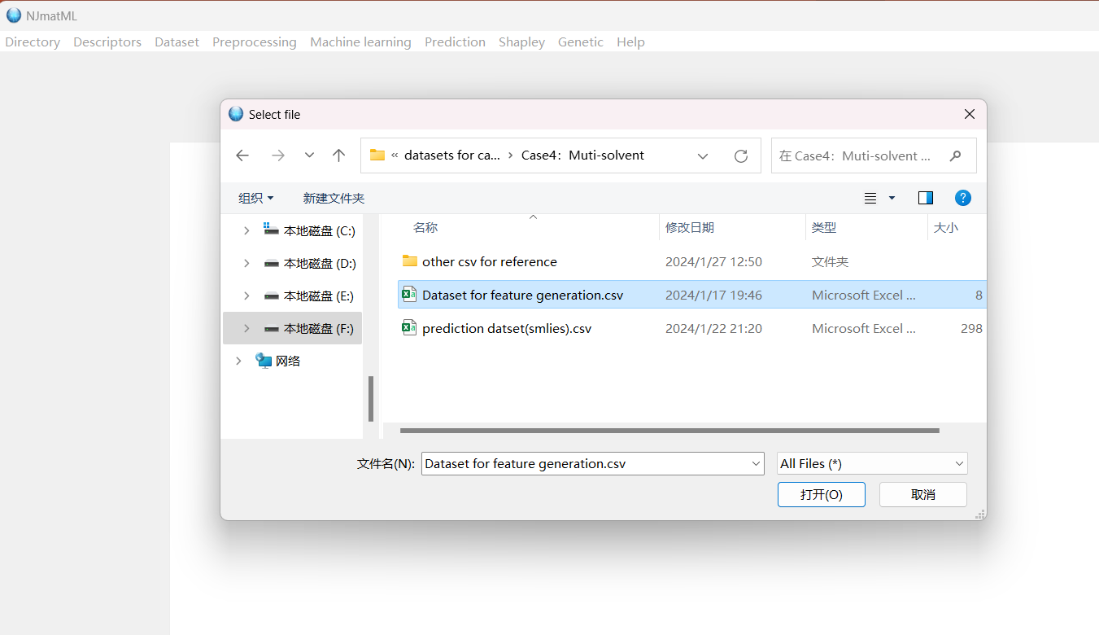
Feature generation
Data import
After data import, click the button ‘featurize’!

Slide 5
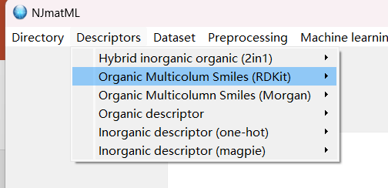
Feature generation
Click this button and import data

Slide 6
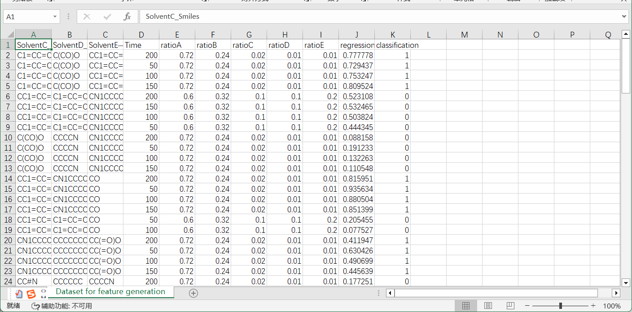
Dataset display before feature generation
Input 1: SMILES for multiple organic molecules
Input 2: Additional experimental variables such as concentration ratio
Output: stable and unstable (0 and 1)

Slide 7
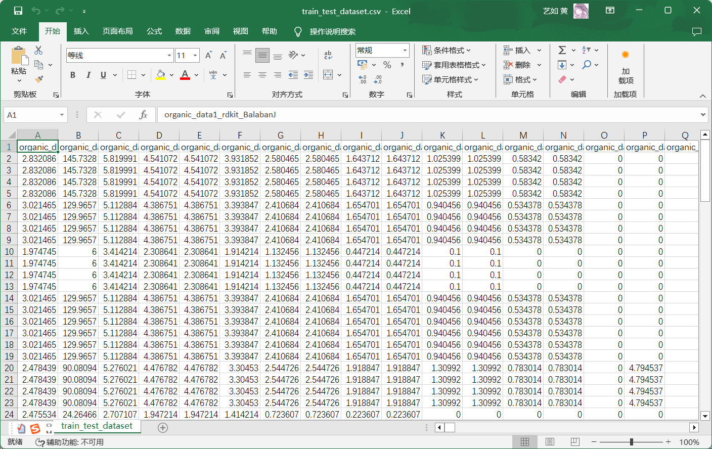
Dataset display after feature generation
Feature generation finishes and the file is named as “train_test_dataset.csv”

Slide 8
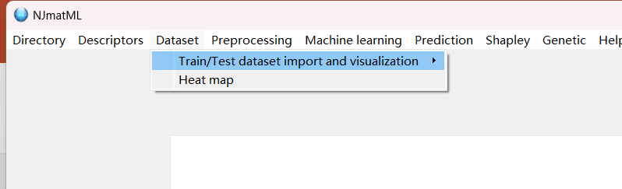
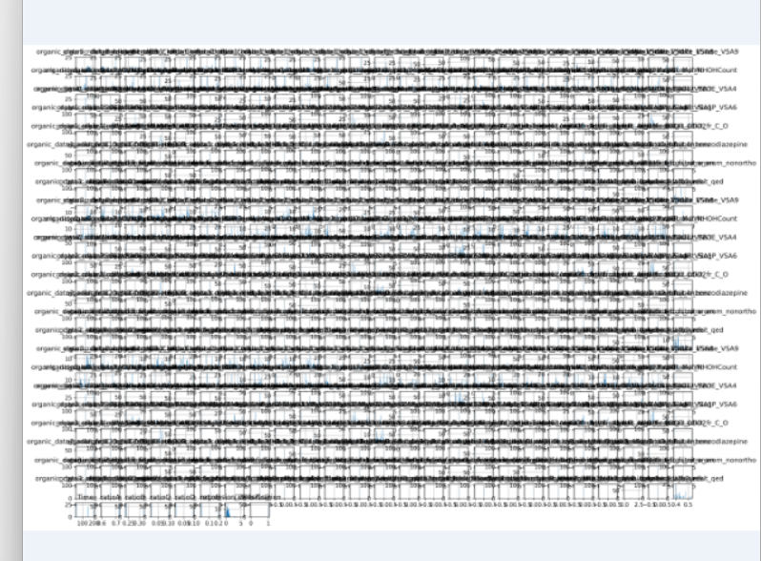
Data import and visualization
Click this button, and import “train_test_dataset.csv”
After import the dataset, click the button “visualize”, you can obtain a data visualization plot:

Slide 9
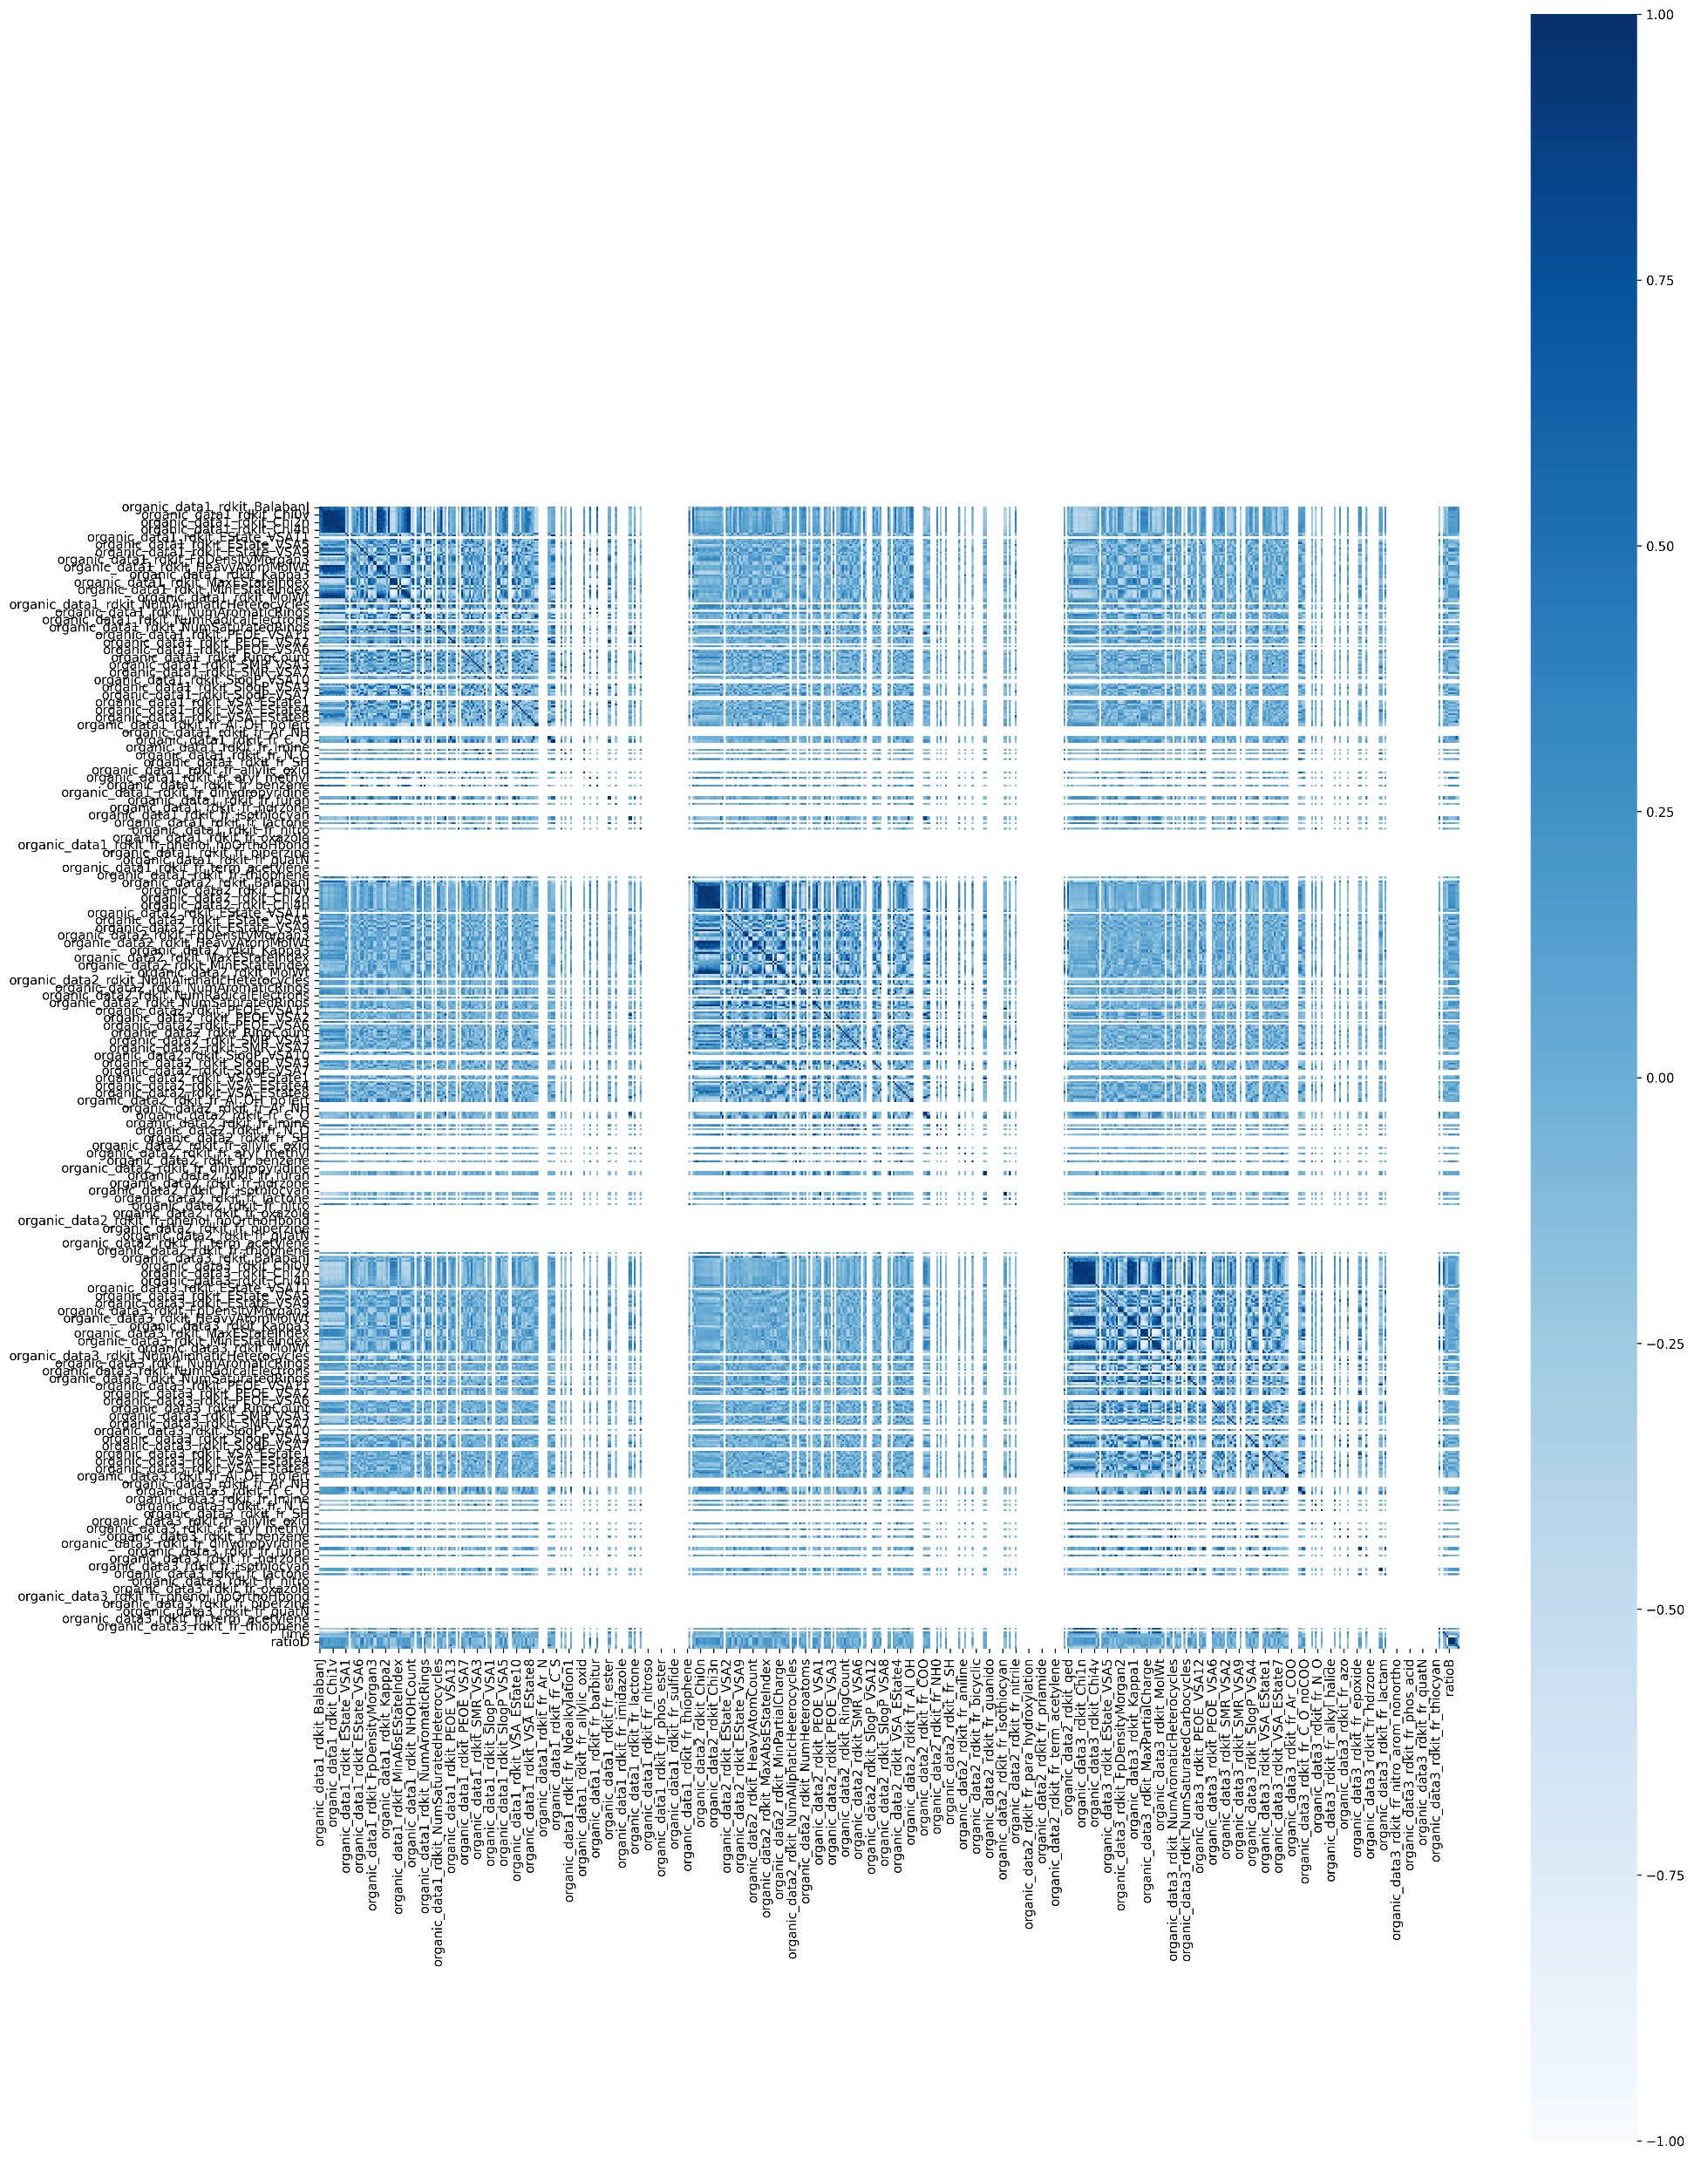
Data import and visualization
After clicking the button “Heat map”, you can obtain a heatmap

Slide 10
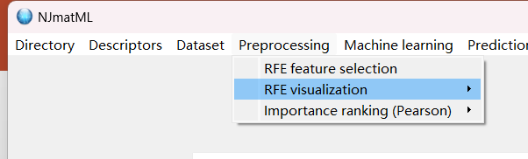
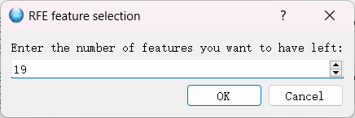
Feature selection
Click this button “RFE feature selection ”
Input “19” as an example, actually you can select as many features as you want

Slide 11
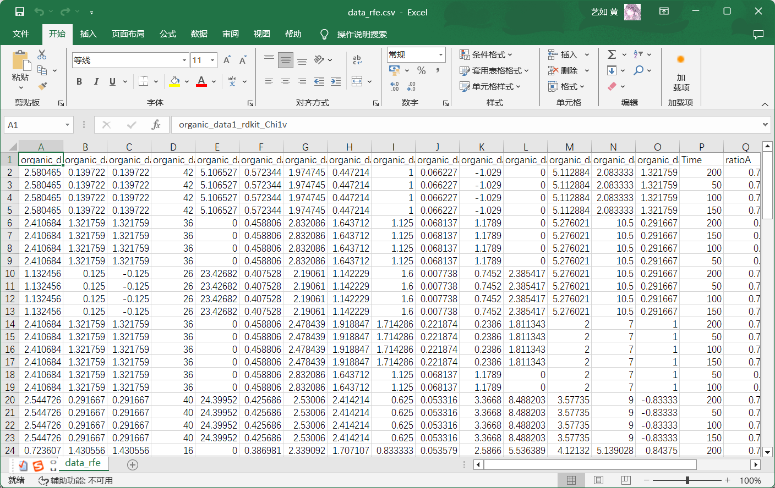
Dataset after feature selection
Feature selection finishes and the file is named as “data_rfe.csv”

Slide 12
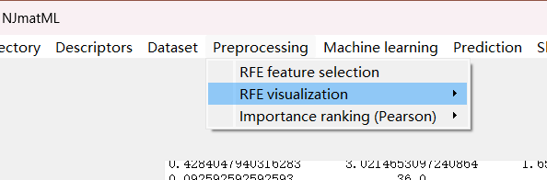
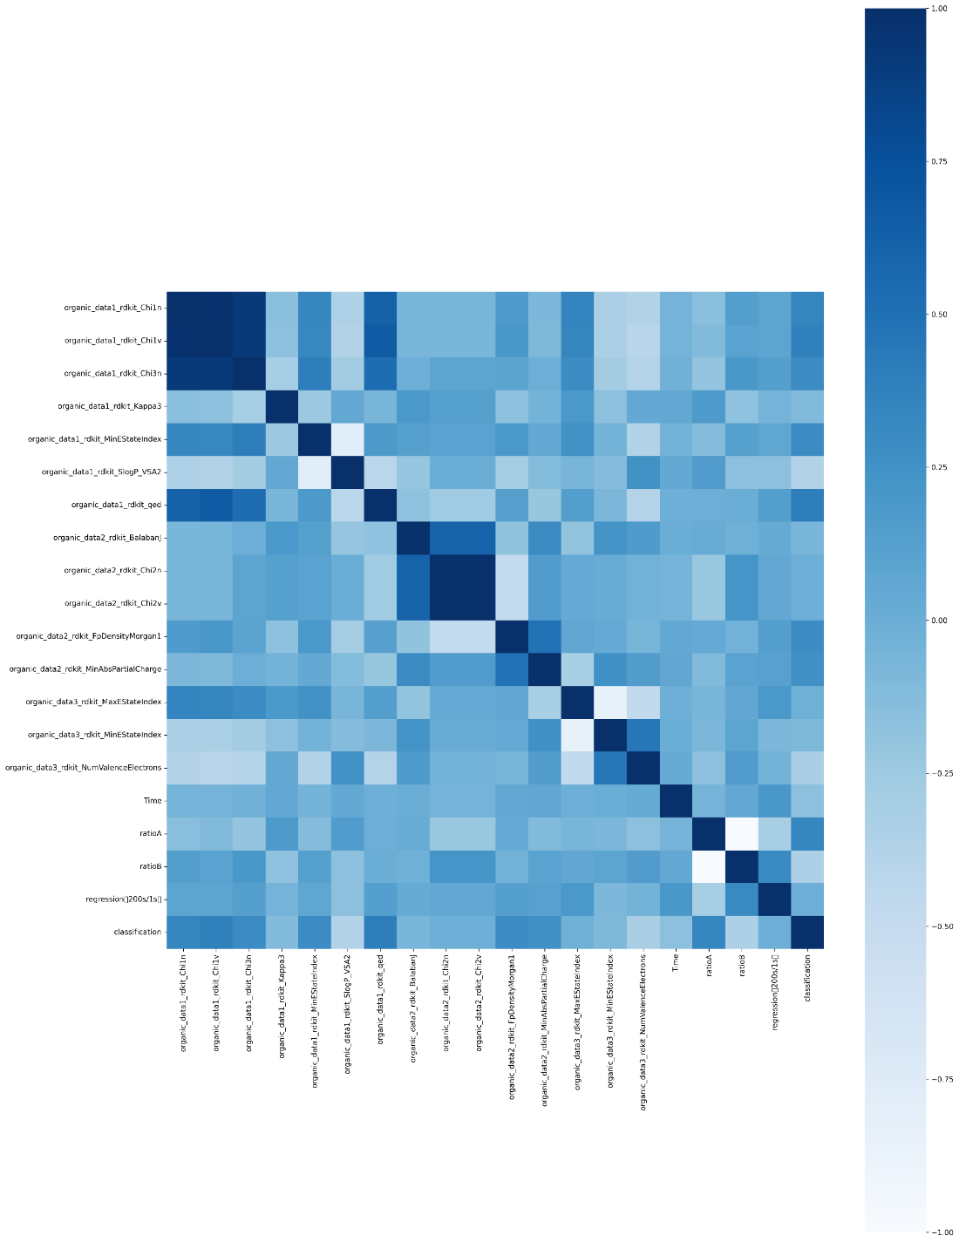
RFE visualization
Click the button “RFE visualization” and “RFE heatmap”, then you can obtain:

Slide 13
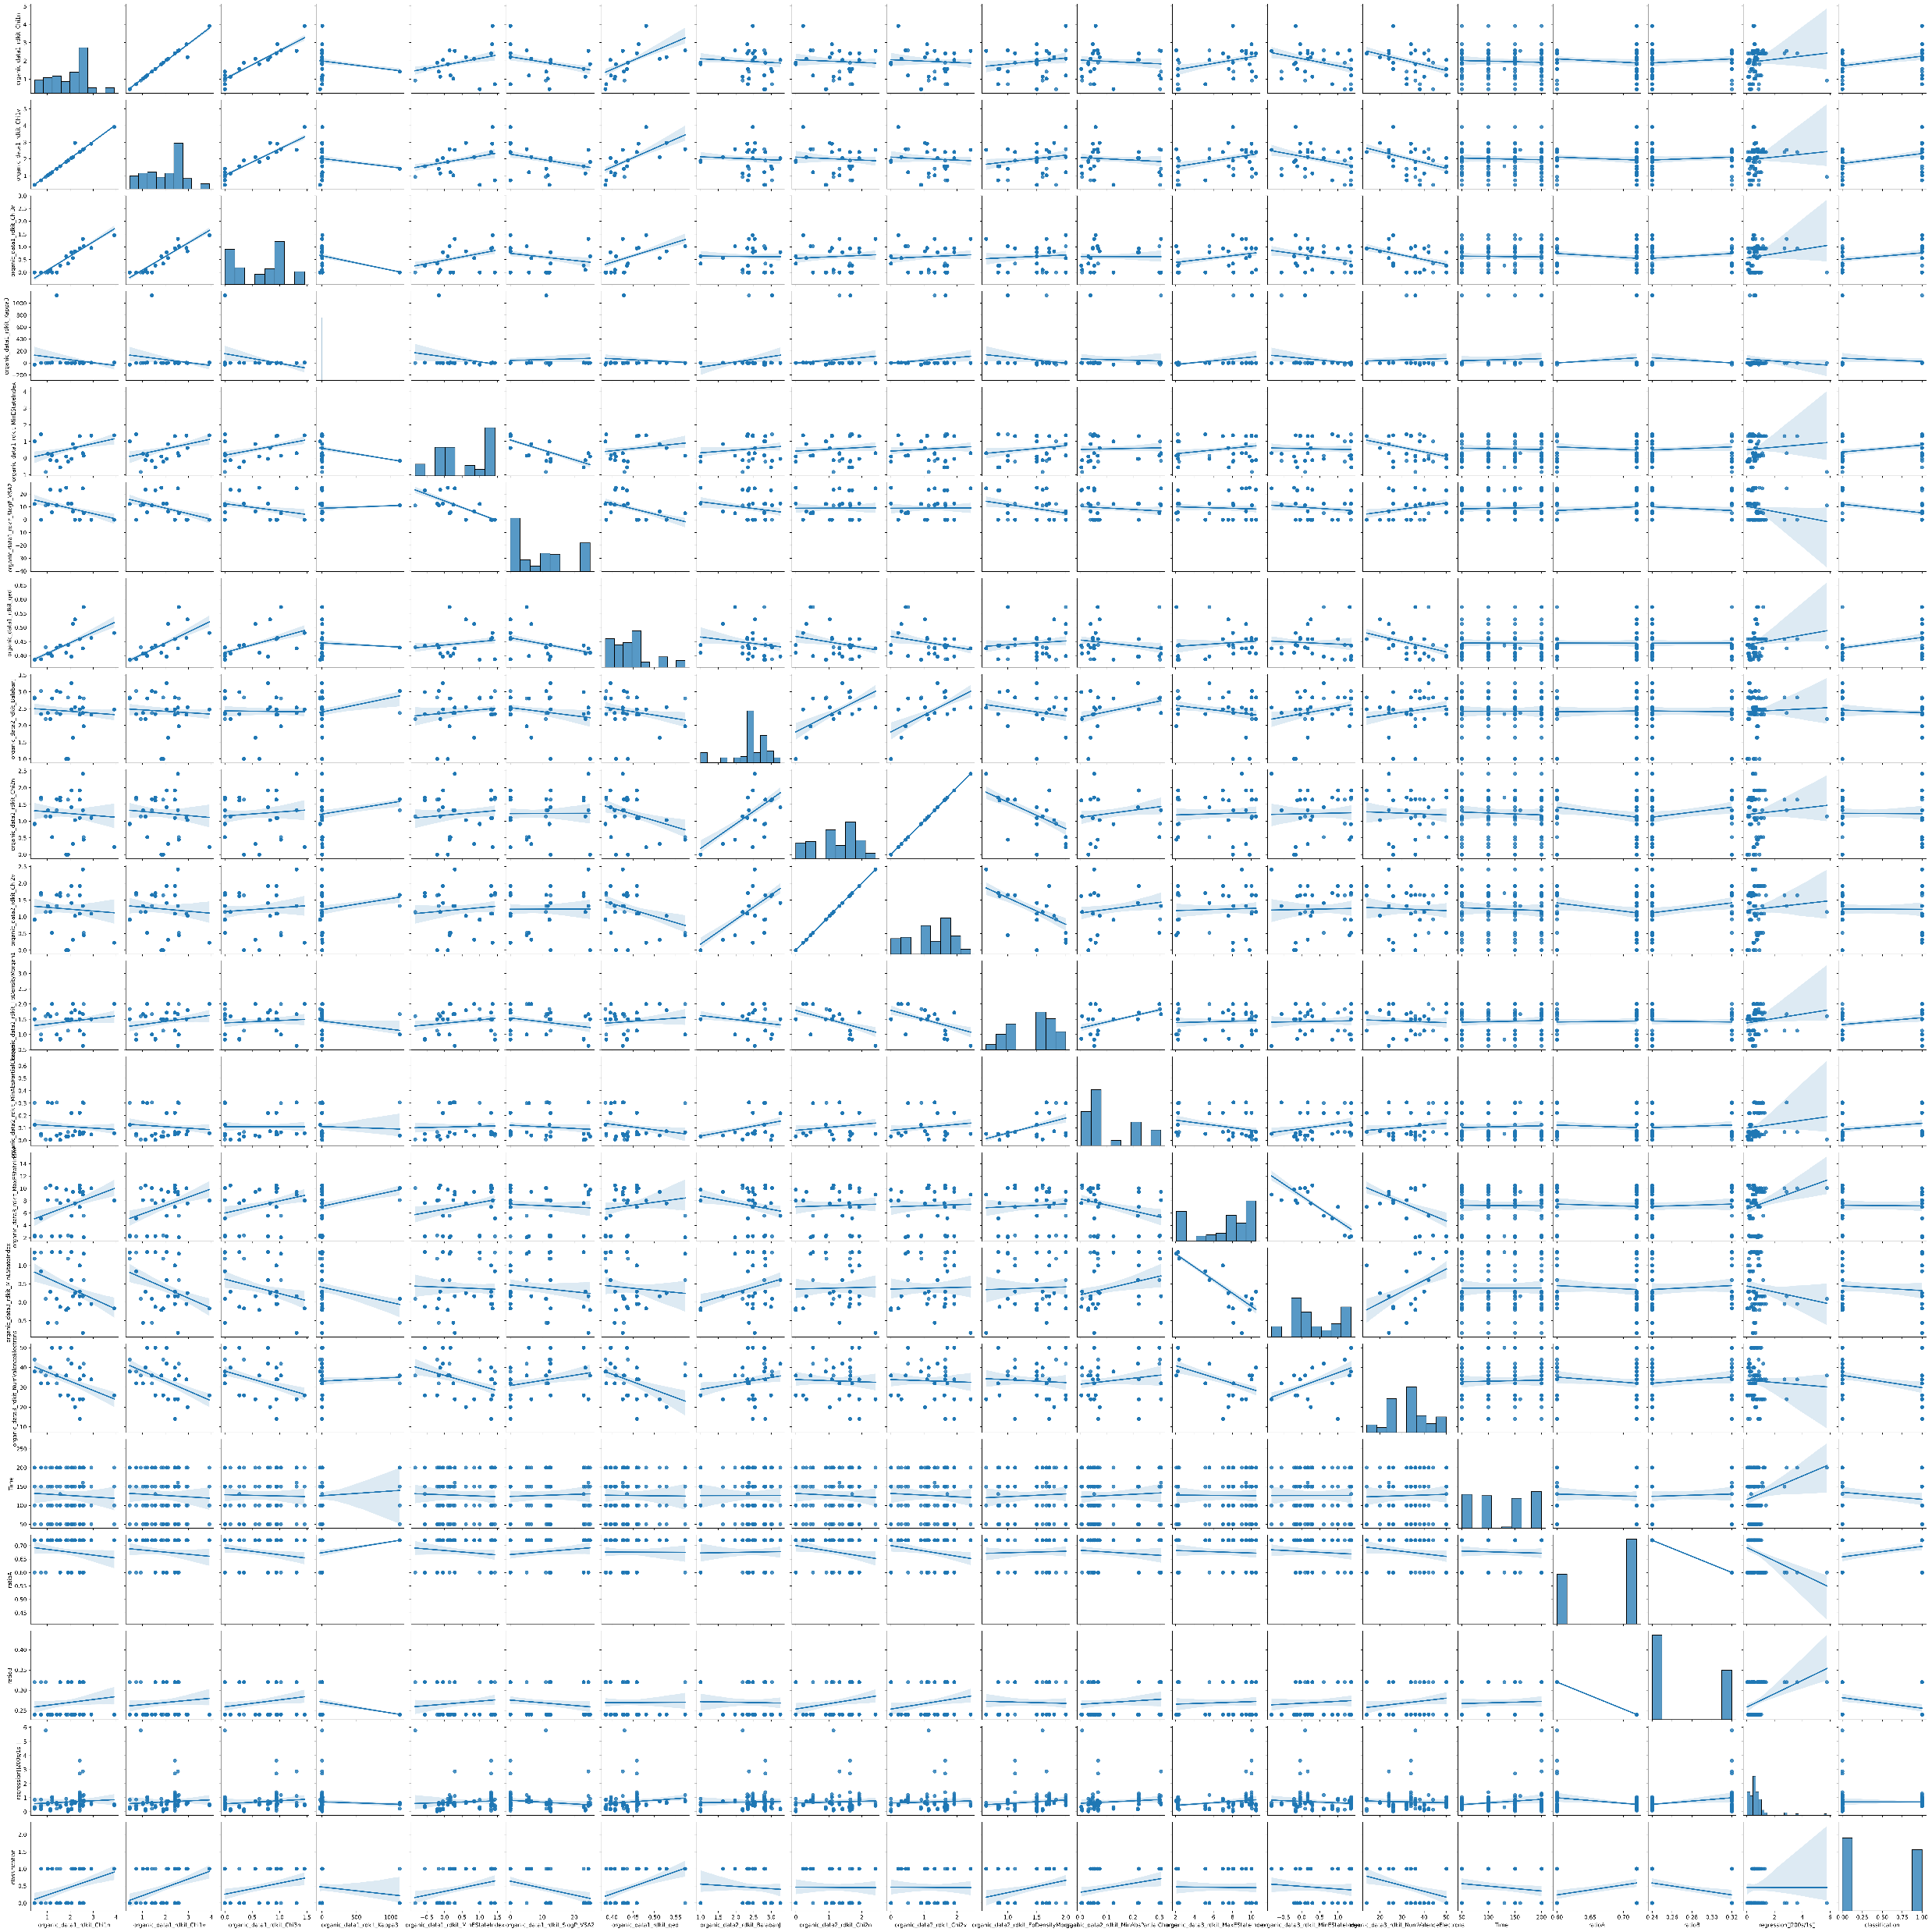
RFE visualization
Click the button “RFE pairplot”, you can visualize the dataset via pairplot:

Slide 14
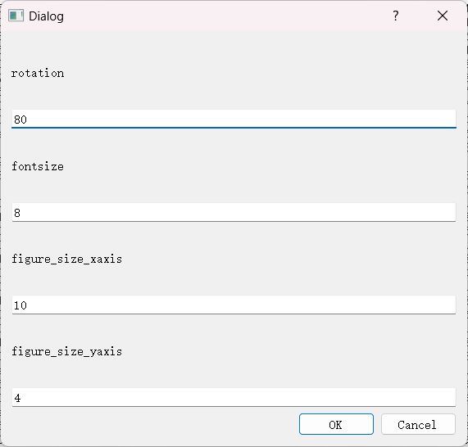
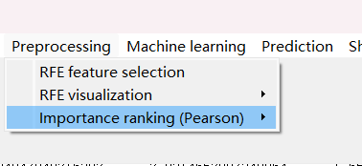
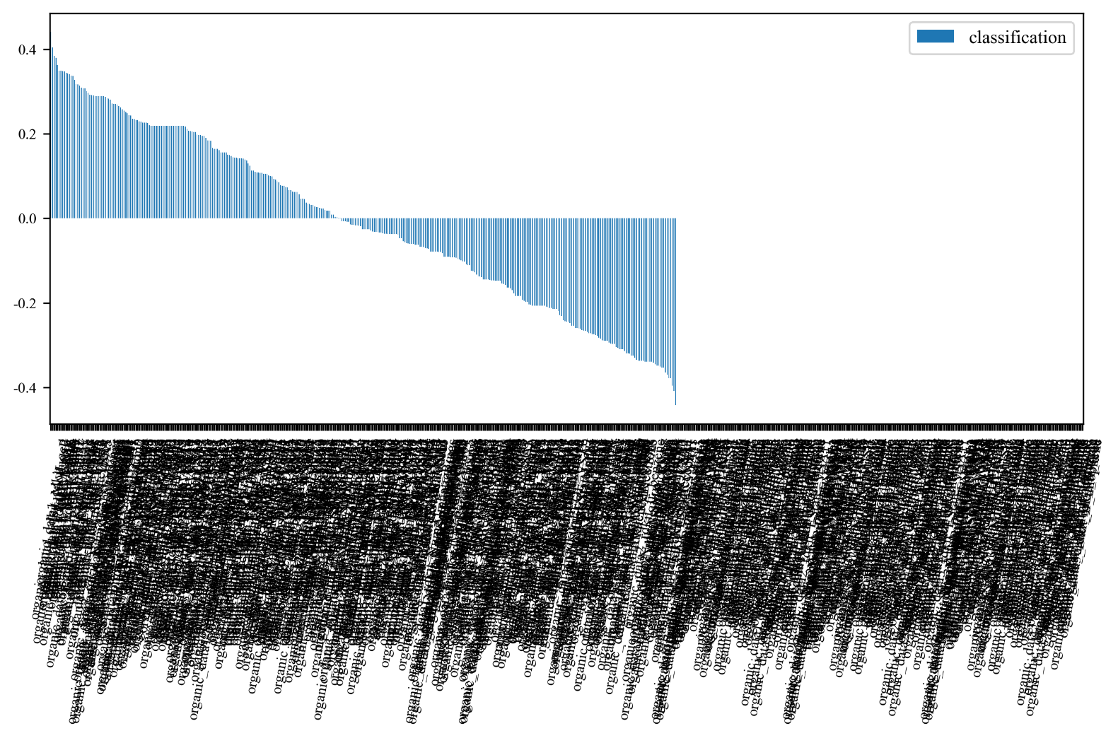
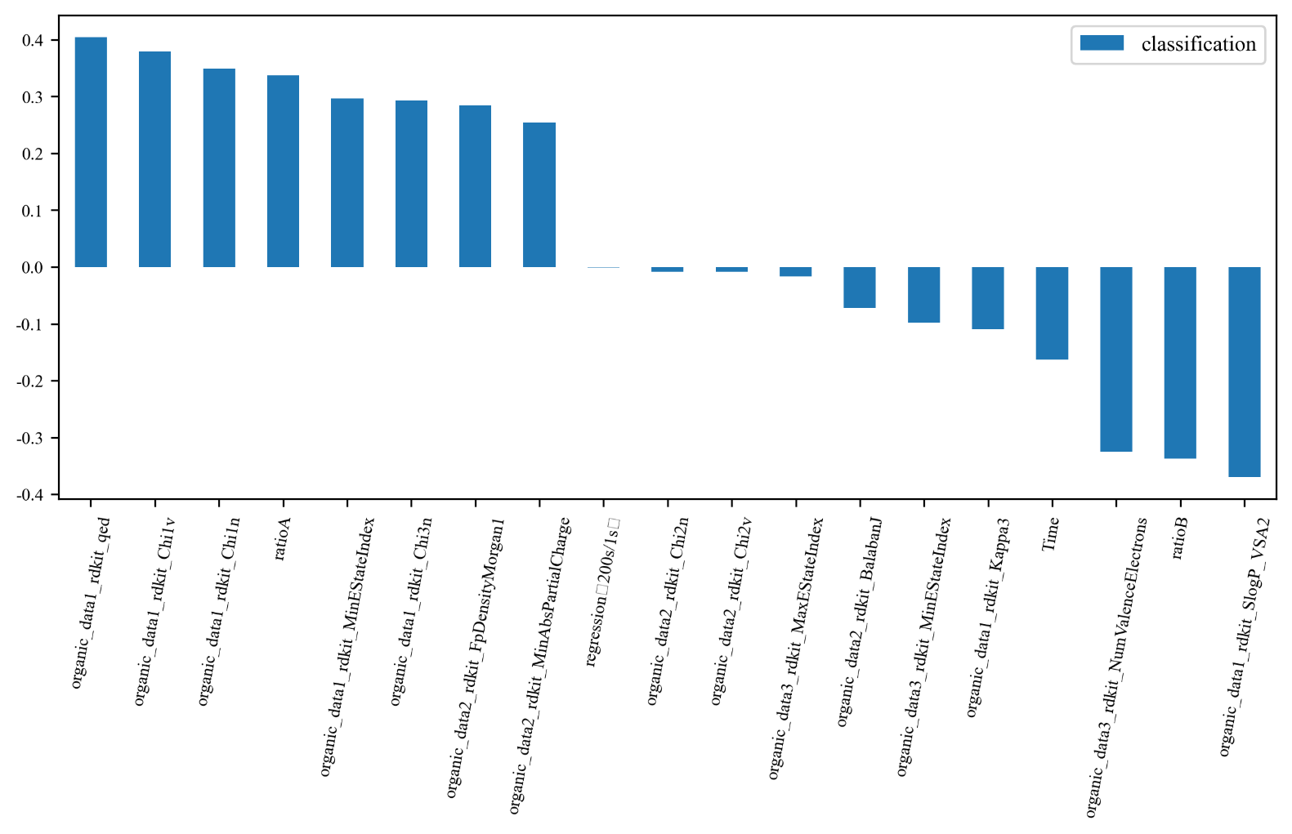
Feature importance ranking (Pearson)
Click the button “importance ranking (Pearson)”, you can obtain a feature importance ranking plot before and after feature selection
Parameters
Before RFE feature selection
After RFE feature selection

Slide 15
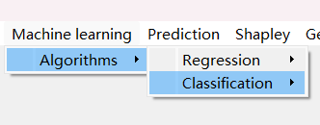
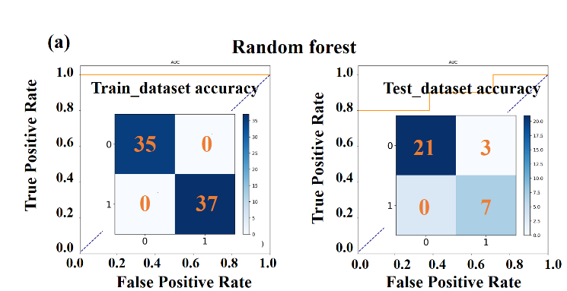
Machine learning model
Click the button “classification”, where you can choose from various algorithms, including random forest, extra trees, Gaussian process, decision trees and SVM.
For example, if you choose the random forest algorithm, you will obtain confusion matrices and ROC plots based on the test dataset and the train dataset:

Slide 16
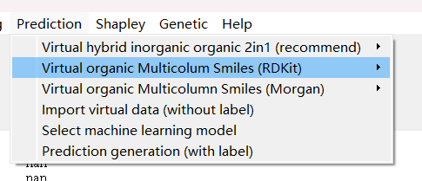
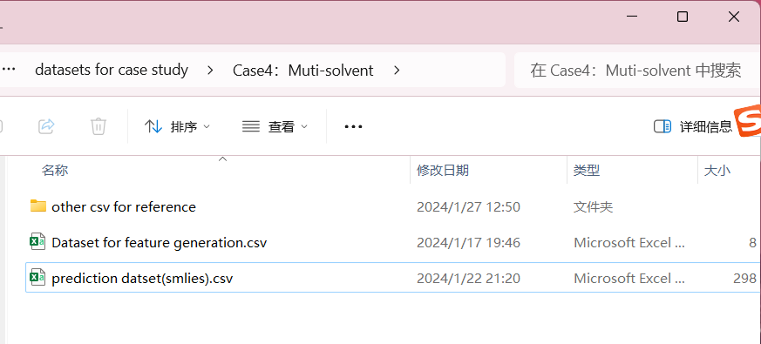
Prediction dataset generation
Click this button (else if both organics and inorganics are present in the dataset, you should choose 2in1)
Choose this file and import

Slide 17
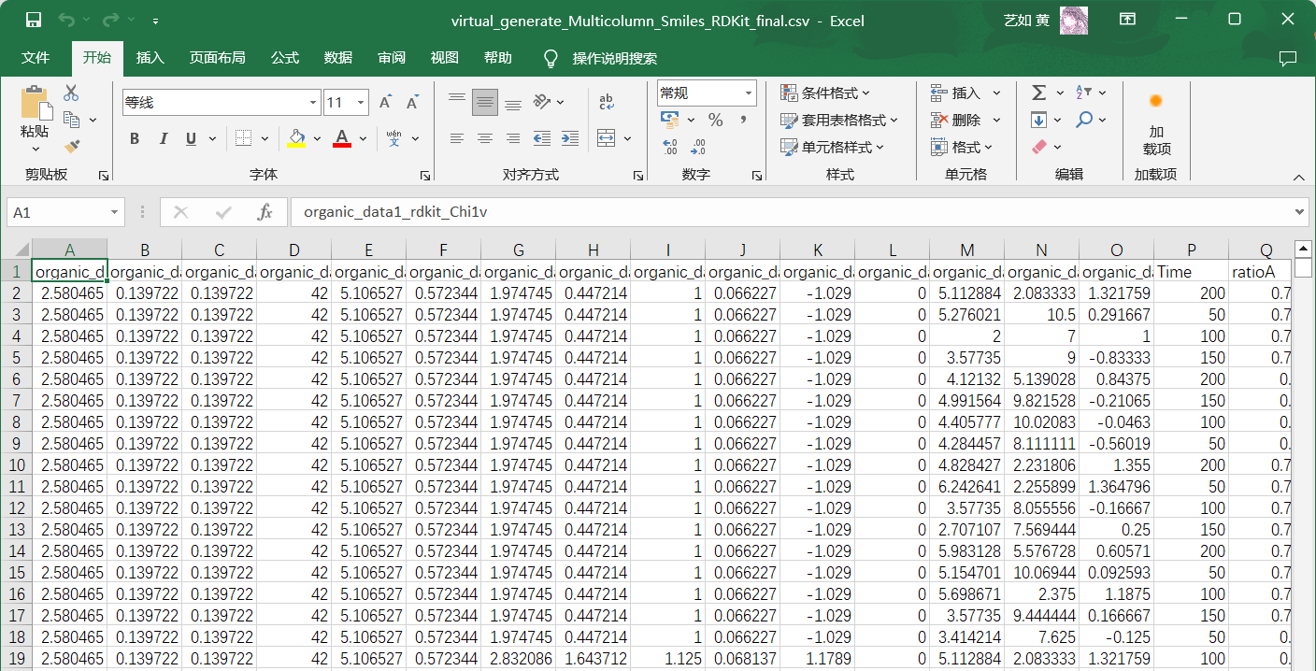
Prediction dataset generation
After data import, click the button “generation” and the prediction dataset with the same RFE input features (but without output labels) will be generated:
The file is named as “virtual_generate_Multicolumn_Smiles_RDKit_final.csv”

Slide 18
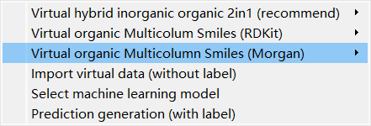
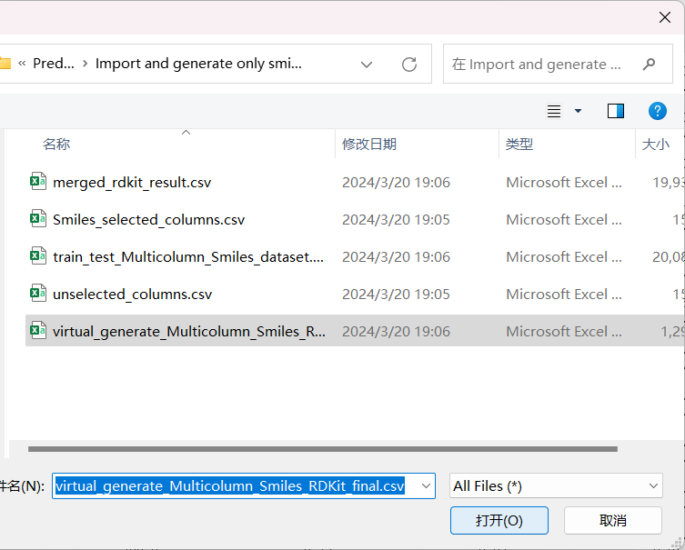
Prediction
Click this button, and select “virtual_generate_Multicolumn_Smiles_RDKit_final.csv”

Slide 19
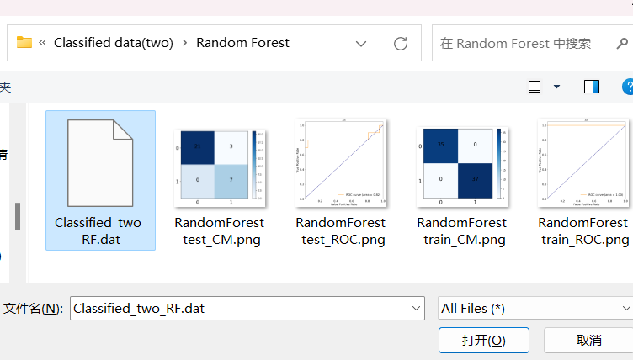
Prediction
Click this button, and select the machine learning model such as random forest (the model file ends with .dat):

Slide 20
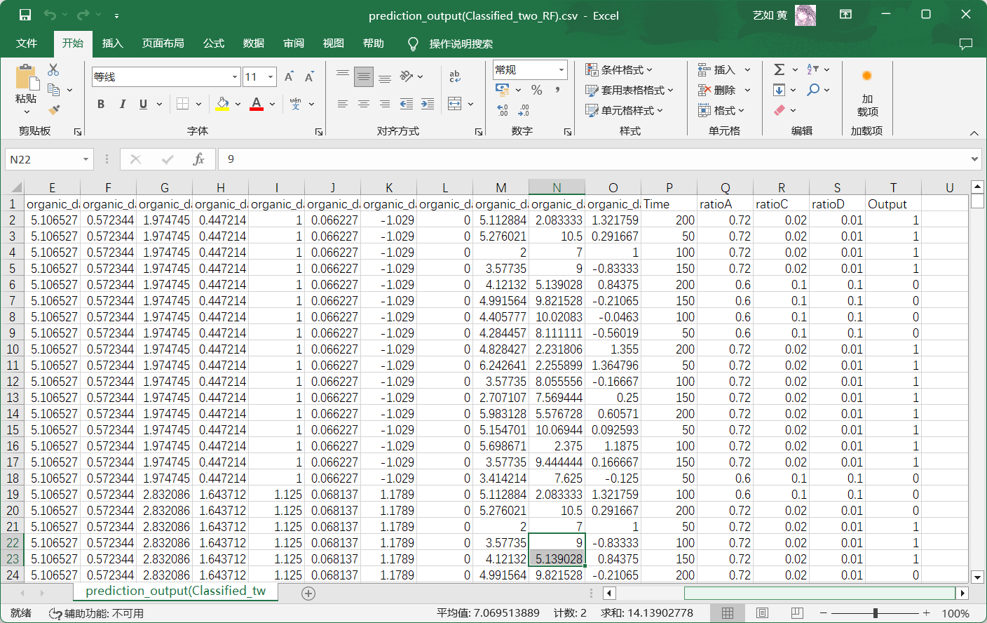
Prediction
Click the button “prediction generation (with label)”, and the prediction process finishes !

Slide 21
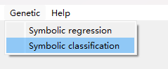
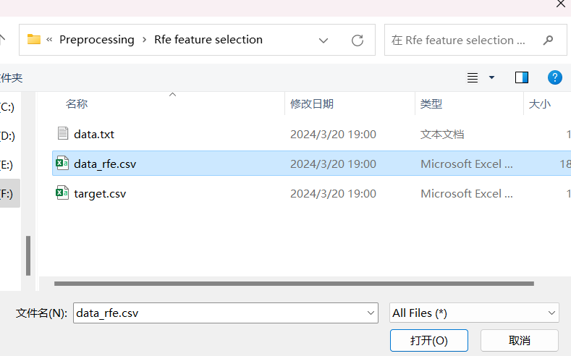
Genetic algorithms
Click the button “Symbolic classification”, and choose the file “data_rfe.csv’’
The present task is classification, so the Symbolic classification button is chosen; else if the task is regression, please choose “Symbolic regression”.

Slide 22
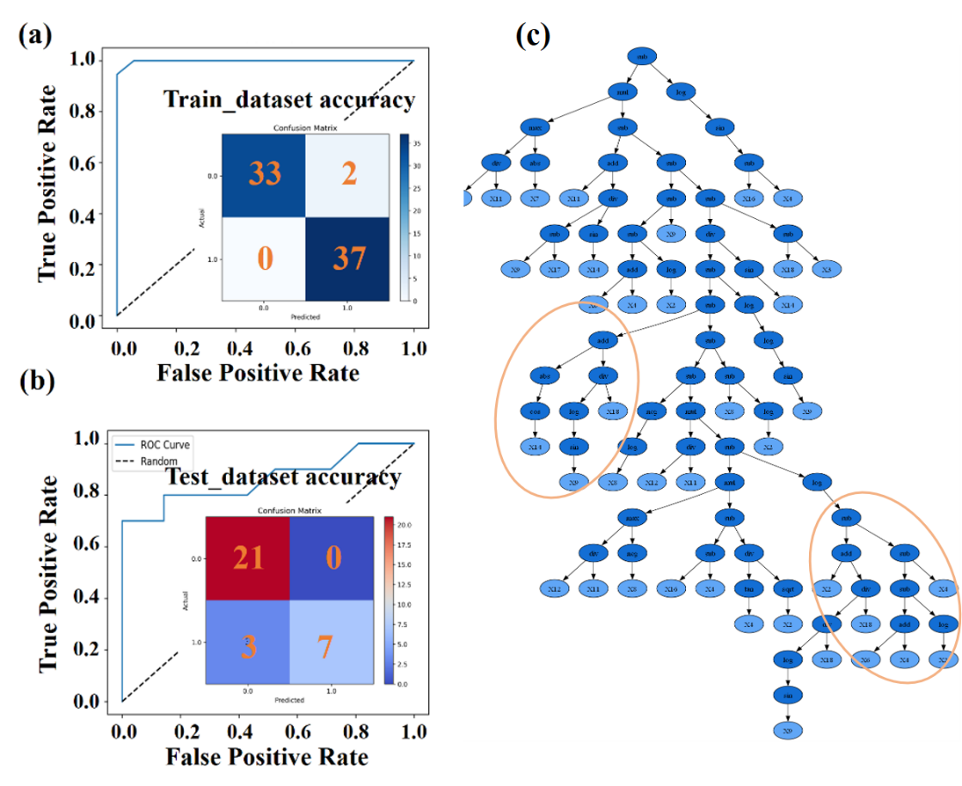
Genetic algorithms
After data import, please waiting for some minutes
Then you can obtain confusion matrices, ROC plots and expression trees plots.
If you can not find it, please go to the path “GP/Symbolic classification” (“GP/Symbolic regression” if the task is regression).

Slide 23
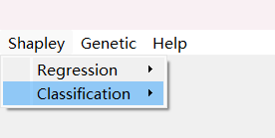
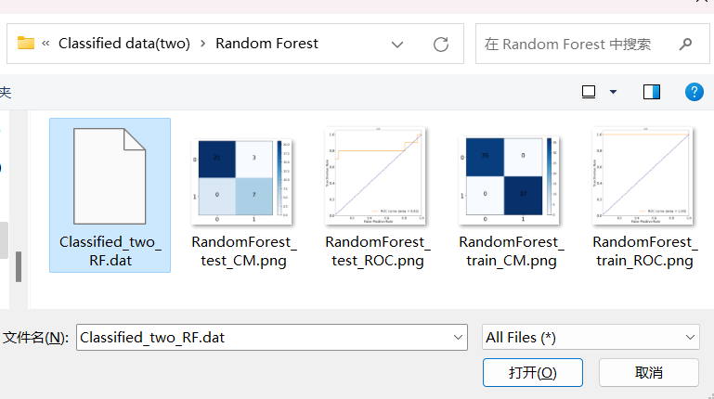
SHAP feature analysis
Click the button “Shapley/Classification/Model import’’ (else if the task is regression, you should choose “Shapley/Regression/Model import’’ )
Choose the machine learning model such as random forest (Classified_two_RF.dat)

Slide 24
SHAP feature analysis
After model import, click the button “data import” , choose the file “data_rfe” (Path: Preprocessing\Rfe feature selection)

Slide 25
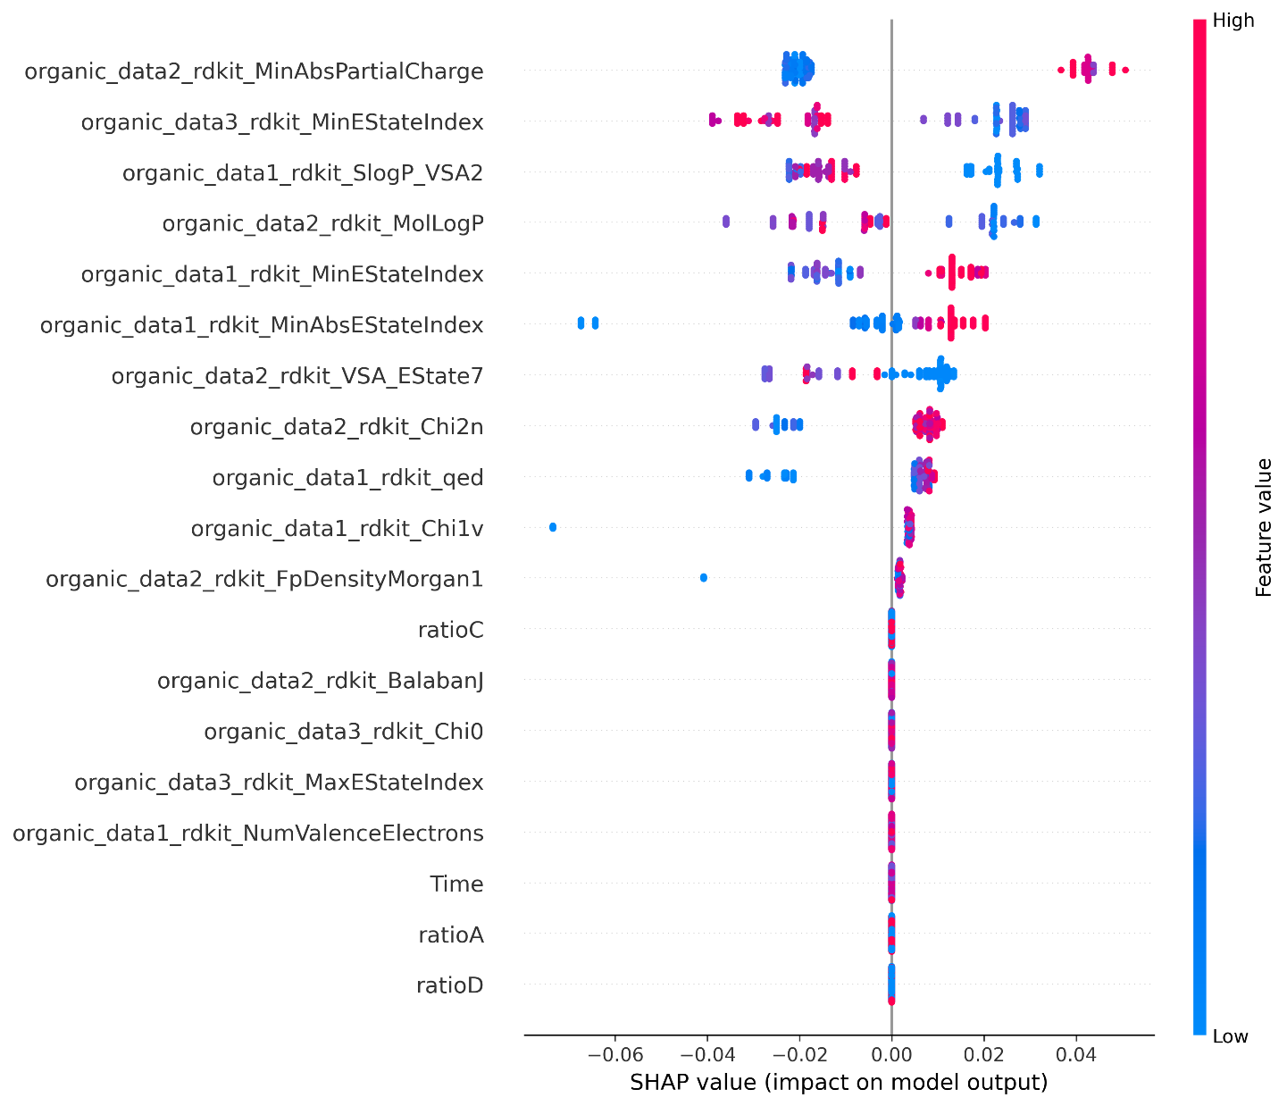
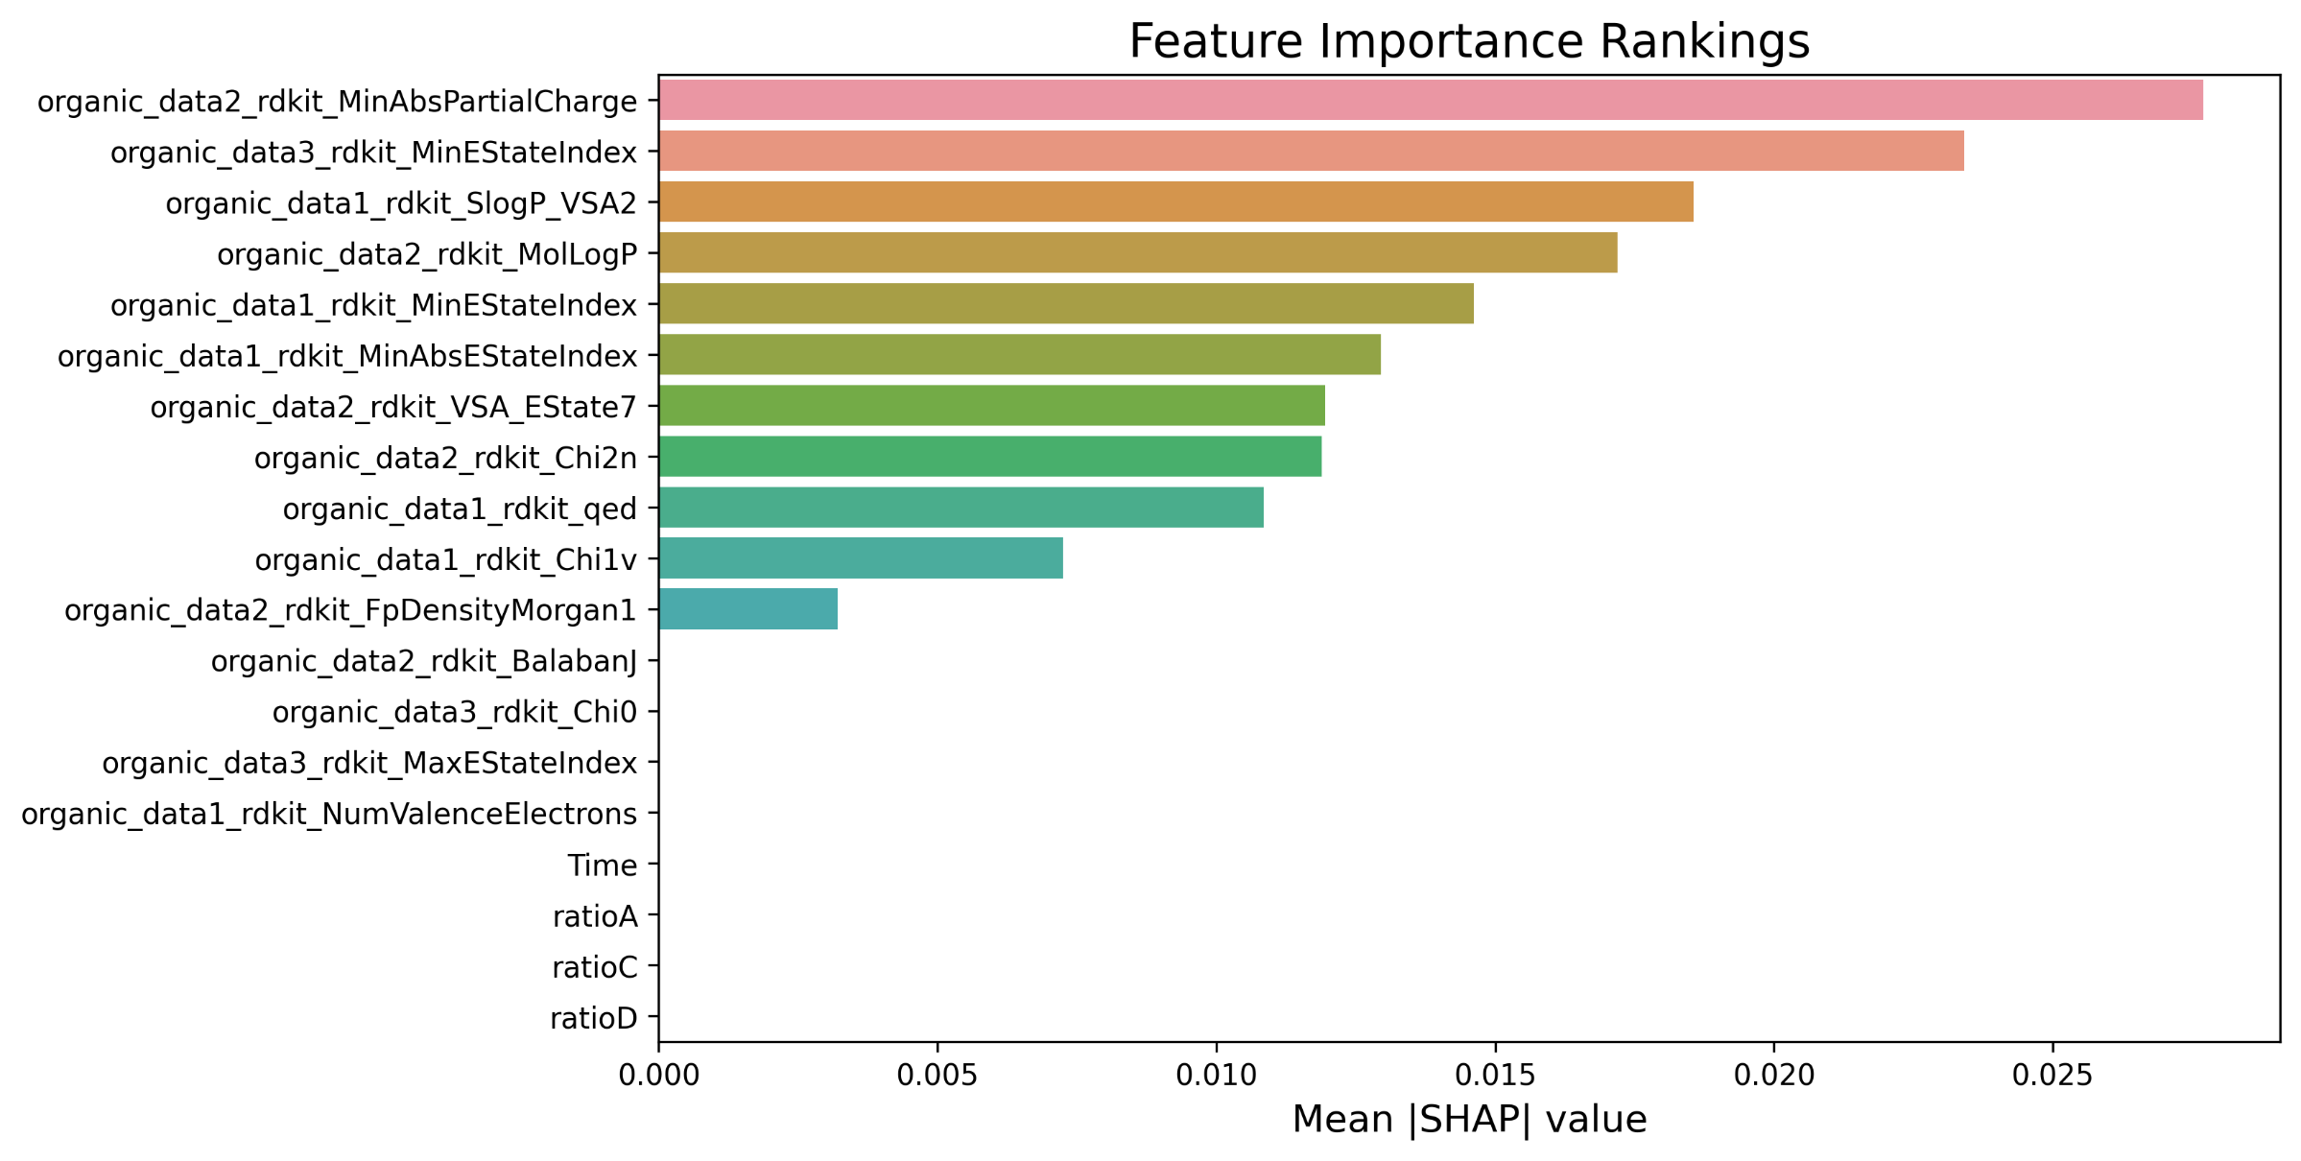
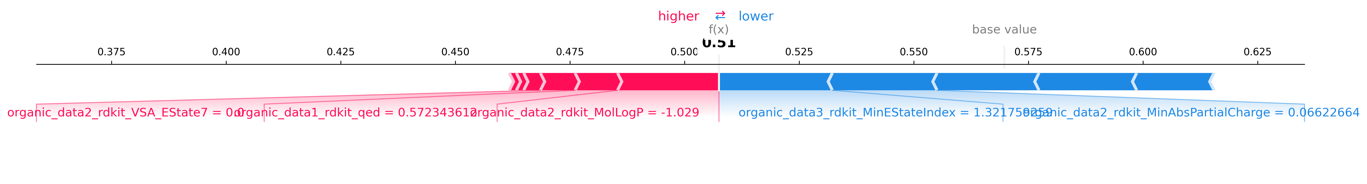
SHAP feature analysis
Click the button “Result”, and you can obtain:
Feature importance ranking plot
Summary plot
Force plot

Slide 26
Thank you!

